Slide 1


Slide 2

Index/Contents/Intent
List of Abbreviations
List of Figures
List of Graphs
List of Tables and List of if any other inclusion
INTRODUCTION
LITERATURE SURVEY
SYSTEM DEVELOPMENT
PERFORMANCE ANALYSIS
CONCLUSIONS
Paper Published certificates
References
Appendices
Acknowledgement
Guidelines for Report Writing

Slide 3

1.1 Introduction
1.2 Necessity
1.3 Objectives
1.4 Theme
1.5 Organization
Guidelines for Report Writing

Slide 4

Literature Survey
Related information available in standard Books, Journals, Transactions, Internet Websites etc. till date (More emphasis on last three to five years)
Guidelines for Report Writing

Slide 5

Model Development
Analytical
Computational
Experimental
Mathematical
Statistical
(out of above methods at least one method is to be used for the model development)
Some mathematical treatment or related information is required to be embodied
Guidelines for Report Writing

Slide 6

Analysis of system developed either by at least two methods depending upon depth of standard
These methods normally used are Analytical /Computational/Statistical/Experimental/ or Mathematical
Results at various stages may be compared with various inputs
Output at various stages with same waveforms or signals or related information/parameters
Comparison of above results by at least two methods and justification for the differences or error in with theory or earlier published results
Guidelines for Report Writing

Slide 7

5. CONCLUSIONS (1-3 Pages)
5.1 Conclusions
5.2 Future Scope
5.3 Applications
Guidelines for Report Writing

Slide 8
Contributions (if any, 1 Page)
The innovative work/invention/new ideas generated from the analysis of the work which can be taken from the conclusions
Guidelines for Report Writing

Slide 9
References
Author, “Title”, Name of Journal/Transactions/ Book, Edition/Volume, Publisher, Year of Publication, page to page (pp.__).
These references must be reflected in text at appropriate places in square bracket
In case of web pages complete web page address with assessing date has to be enlisted
List of references should be as per use in the text of the report
Guidelines for Report Writing

Slide 10

Appendices
Related data or specifications or referred charts, details computer code/program, etc.
Guidelines for Report Writing

Slide 11

Acknowledgement
Expression of gratitude and thankfulness for helping in completion of the said task with name
Signed by the candidate
Guidelines for Report Writing

Slide 12

Text should be printed on front and correct side of the watermark on quality bond paper
Paper size- A4, 75 to 85 gsm paper
Left Margin-1.5”
Right Margin-3/4”
Top Margin-1”
Bottom Margin-1”
Guidelines for Report Writing

Slide 13

First page of first chapter need not be printed anywhere
Second page onwards at right hand corner at ½ inch from right and top side
From second chapter onwards starting page number of chapter should be printed at bottom center place
Undergraduate report total pages –around 70-100
Postgraduate Dissertation total pages –around 80-150
Ph. D. Thesis total pages –around 100-250
Guidelines for Report Writing

Slide 14

Follow American English
Example
  Fulfilment
  Traveling
  Meter
  Preferably use ‘LATEX’ software for writing
All Greek words must be italic
Guidelines for Report Writing
Continued…….

Slide 15

Report Heading -All Capital—16 Font
Chapter heading -All Capital—14 Font
Subchapter –title case-12 Font
Sub-Subchapter –First Alphabet Capital case-12 Font
Page numbers for Index/Contents/Intent should be in roman
Title of the Report should not be more than two lines
Text pages should be in times new roman
The page of the Index/Contents/Intent heading should be below the words for appropriate sub chapter or sub-sub chapter as shown in sample copy
Cover page should have (Mission statement of Institute) in inverted commas, Symbol of Institute, Name of Department, and Institute
Guidelines for Report Writing

Slide 16

Black color, golden screen printed or embossed
Width of report should have front side degree-B. E.
Central place for Title and lower place for year of submission [B. E. ]
Guidelines for Report Writing

Slide 17

Suitable flap with name of the candidate, Department and Institute name and symbol can be used with nylon strip
Guidelines for Report Writing

Slide 18

(Report)
1”
B. E. (UG)
Title
Golden Color Strips
1”
2022-23
Guidelines for Report Writing

Slide 19


Guidelines for Report Writing

Slide 20

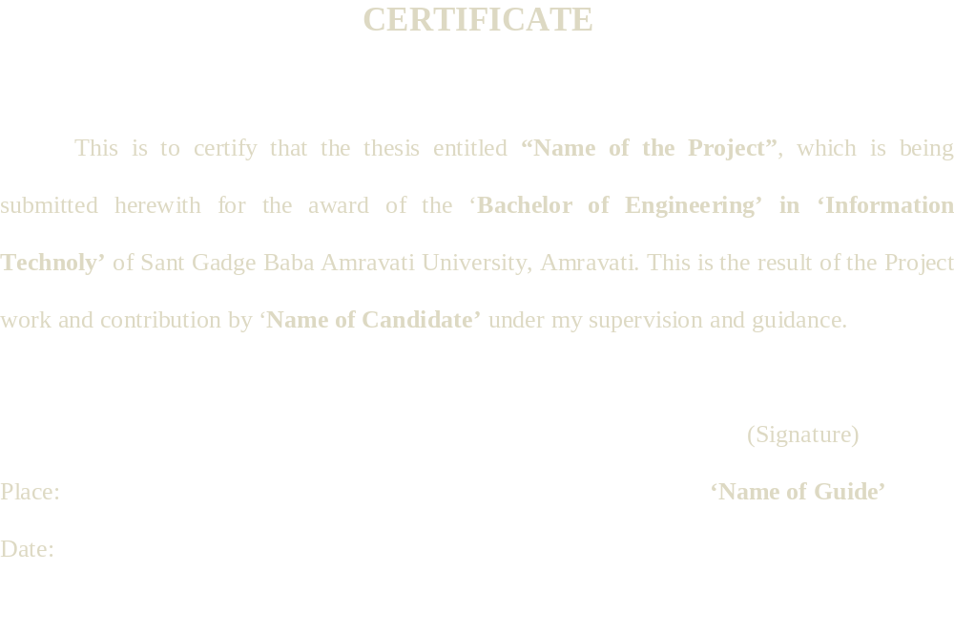
Guidelines for Report Writing

Slide 21

Attach the certificates of the Paper Published in UGC listed Journals at the end before references.
Guidelines for Report Writing

Slide 22

V. Ekechukwu and B. Norton, “Experimental Studies of Integral-Type Natural-Circulation Solar-Energy Tropical Crop Dryers”, ‘Energy Conversion and Management’, Volume 38, Issue 14, September 1997, Pages 1483-1500 .
Aldo V. Da Rosa, “Fundamentals of Renewable Energy Processes”, Elsevier Academic Press, 2005, pp. 448, 466-469.
http://www.saveenergyindia.com/enscene/worldscn.htm, access date: 18th Dec. 2006.
Tariq Muneer, “Sustainable Production of Solar Electricity With Particular Reference to the Indian Economy”, ‘Renewable and Sustainable Energy Reviews’, 9 (2005), Elsevier, pp. 448, 454, 463-469.
Guidelines for Report Writing

Slide 23


Guidelines for Report Writing

